Slide 1
PFA HOUSING PROJECT
GOAL: PREDICTING HOUSING SALES PRICE

Slide 2
DATA EXPLORATION
CONTAINS 80 INPUT FEATURES CONTAINING INFORMATION ABOUT THE PROPERTY:
Linear feet of street connected to property
Lot size in square feet
Type of road access to property
Type of alley access to property
General shape of property
---------
Type of sale
Year Sold (YYYY)
Condition of sale
ONE OUTPUT(PREDICTED) VARIABLE
SalePrice(The price at which the property was sold)
NATURE: CONTINOUS
NUMBER OF ROWS : 1168

Slide 3
ALGORITHMS USED
LINEAR REGRESSION
LASSO
RIDGE
DECISION TREE REGRESSOR
RANDOM FOREST REGRESSOR
ADABOOST REGRESSOR
GRADIENTBOOSTINGREGRESSOR

Slide 4
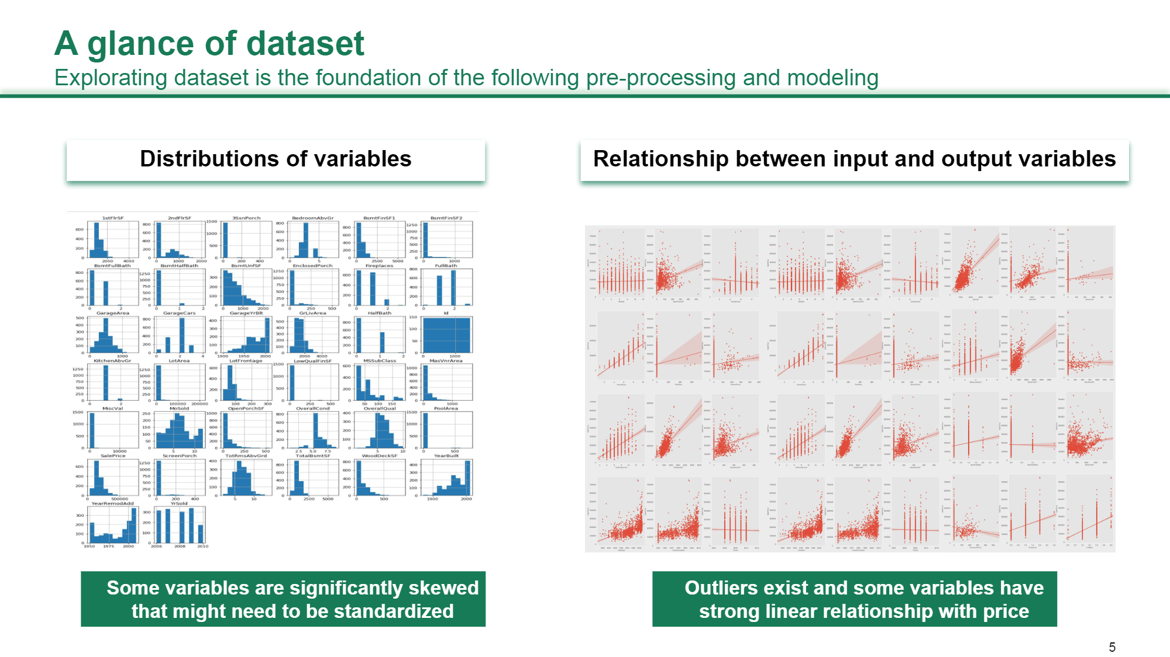
EXPLORATORY DATA ANALYSIS A peek into the dataset

Slide 5
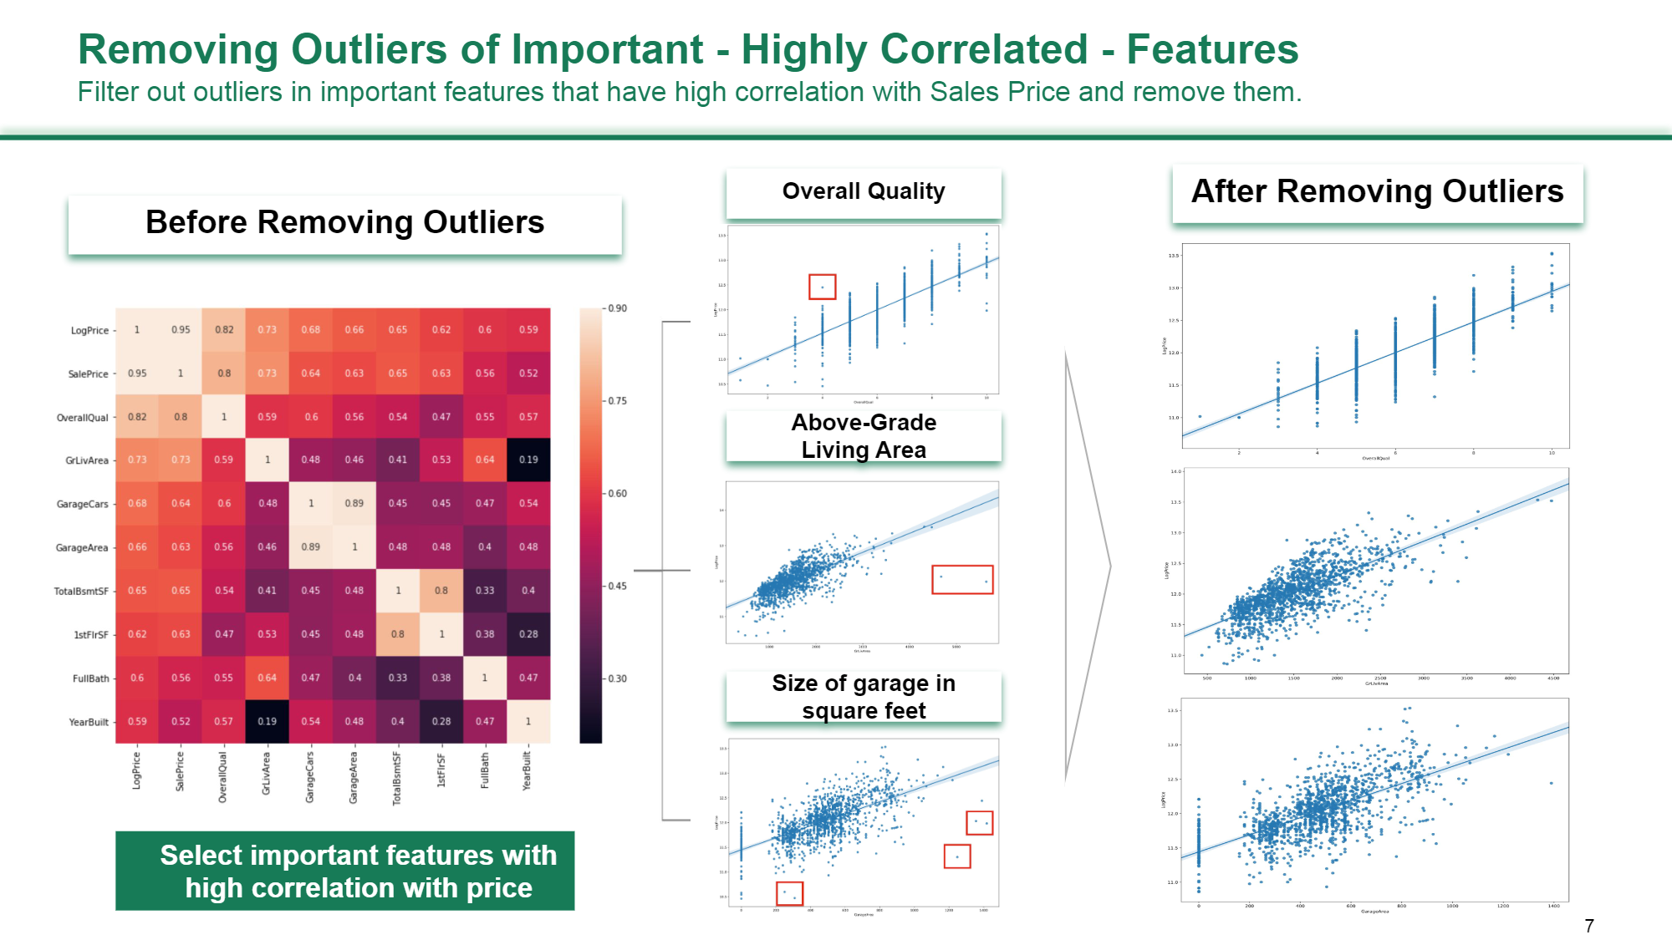

Slide 6
MISSING VALUES

Slide 7
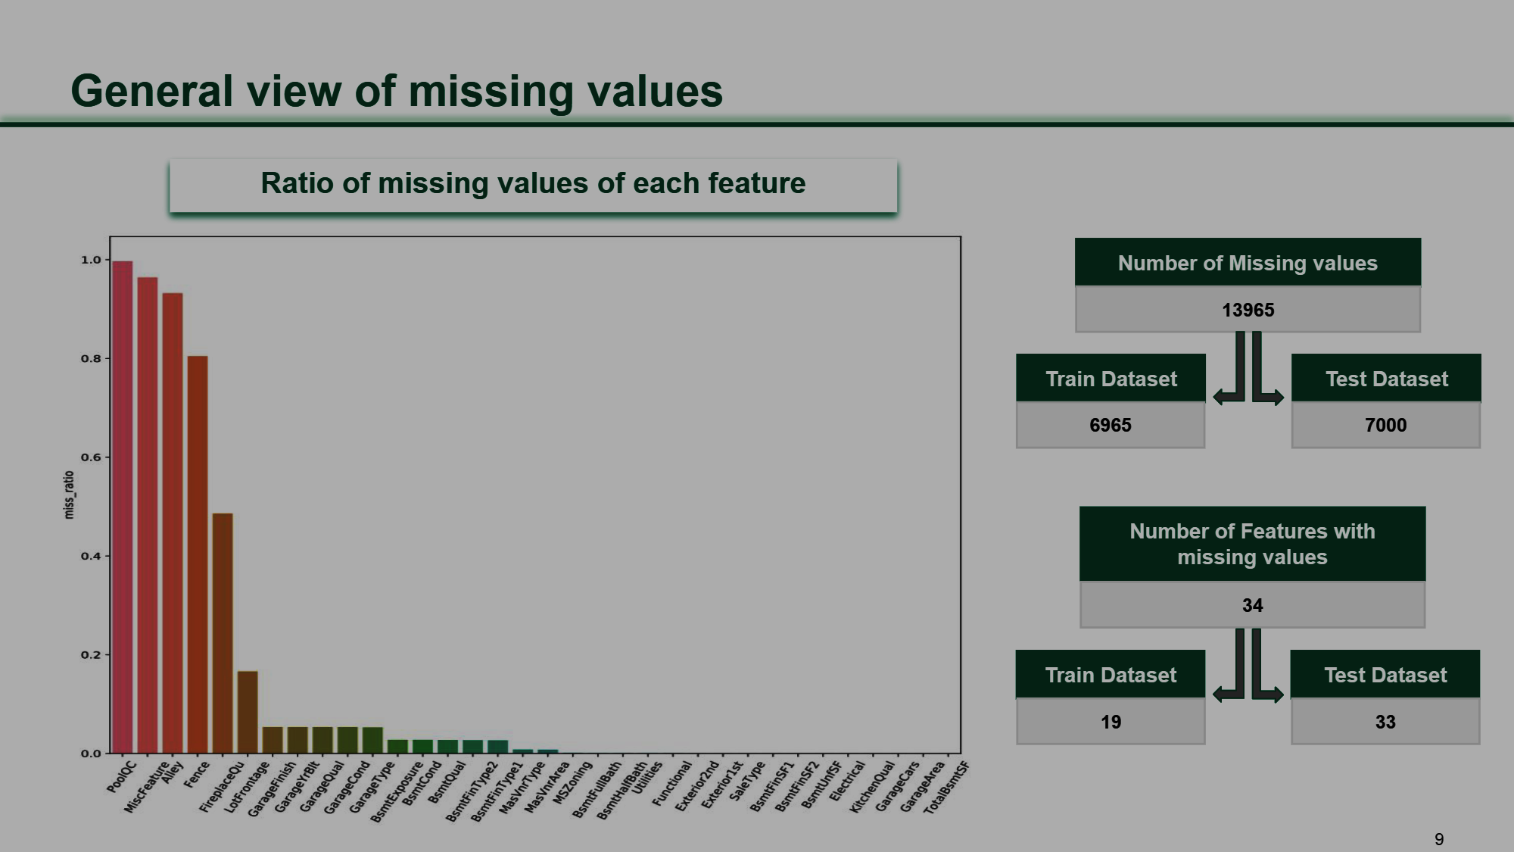

Slide 8
FEATURE ENGINEERING
More than 90% of data was missing in columns:alley,poolqc,miscfeature.Removed these features.
The numerical and categorical feature names were separated in in lists:num_col and object_col respectively for a more organised and specific approach towards feature engineering.
'Totalbsmtsf and 1stflrsf features were merged into totalbsmtsf & 1stflrsf and the former were dropped from the dataset.
Garagecars and garagearea features were merged into garagecars & garagearea and the former were dropped from the dataset.
Totrmsabvgrd and grlivarea features were merged into totrmsabvgrd & grlivarea and the former were dropped from the dataset.

Slide 9
SKEWNESS
THE DATASET WAS THEN CHECKED FOR SKEWNESS USING A HISTPLOT AND features: 'LotFrontage','TotalBsmtSF & 1stFlrSF', 'LotArea','TotRmsAbvGrd & GrLivArea', 'SalePrice all had skewness present in them.
The skewness was removed using log transformation technique.

Slide 10
SKEWNESS: BEFORE AND AFTER LOG TRANSFORMATION
Id -0.004853 MSSubClass 1.394020 LotFrontage 0.004547 LotArea 0.590032 OverallQual 0.014959 OverallCond 0.728678 YearBuilt -0.583781 YearRemodAdd -0.577825 MasVnrArea 1.692685 BsmtFinSF1 0.574263 BsmtFinSF2 4.753041 BsmtUnfSF 0.742732 2ndFlrSF 0.737746 LowQualFinSF 15.502663 BsmtFullBath 0.404771 FullBath 0.032689 HalfBath 0.496141 BedroomAbvGr -0.159870 Fireplaces 0.598419 GarageYrBlt -0.781622 WoodDeckSF 0.945520 OpenPorchSF 1.444519 EnclosedPorch 2.864272 3SsnPorch 28.337255 ScreenPorch 4.758951 PoolQC NaN MiscVal 8.100346 MoSold 0.277080 YrSold 0.112178 SalePrice 0.830901 TotalBsmtSF & 1stFlrSF 0.568578 GarageCars & GarageArea -0.036959 TotRmsAbvGrd & GrLivArea 0.551206
Id -0.004853 MSSubClass 1.394020 LotFrontage -1.450927 LotArea -1.348558 OverallQual 0.014959 OverallCond 0.728678 YearBuilt -0.583781 YearRemodAdd -0.577825 MasVnrArea 1.692685 BsmtFinSF1 0.574263 BsmtFinSF2 4.753041 BsmtUnfSF 0.742732 2ndFlrSF 0.737746 LowQualFinSF 15.502663 BsmtFullBath 0.404771 FullBath 0.032689 HalfBath 0.496141 BedroomAbvGr -0.159870 Fireplaces 0.598419 GarageYrBlt -0.781622 WoodDeckSF 0.945520 OpenPorchSF 1.444519 EnclosedPorch 2.864272 3SsnPorch 28.337255 ScreenPorch 4.758951 PoolQC NaN MiscVal 8.100346 MoSold 0.277080 YrSold 0.112178 SalePrice -0.251090 TotalBsmtSF & 1stFlrSF -0.306919 GarageCars & GarageArea -0.036959 TotRmsAbvGrd & GrLivArea -0.178296

Slide 11
MODEL FITTING(ML)

Slide 12
LINEAR REGRESSION
score: 0.9488184368722168
M.S.E 0.016254007096186053
MEAN ABSOLUTE ERROR 0.08353082192055095
R2 score: 0.8728042034066253
R.M.S.E: 0.12749120399535827
Cross validation: mean score: 0.8889058090007358
cross val score: [0.88785884 0.84830088 0.92879418 0.84723265 0.86347325 0.84701418
0.93403808 0.92216169 0.91375455 0.89642978]

Slide 13
LASSO
score: 0.9200571834654206
M.S.E 0.010617742760808641
MEAN ABSOLUTE ERROR 0.07583264146281114
R2 score: 0.9169108121774174
R.M.S.E: 0.10304243184634494
Cross validation: mean score: 0.9045884133057488
cross val score: [0.91245096 0.94149721 0.91150908 0.89023988 0.92739765 0.87310974
0.90859173 0.94511156 0.87486529 0.86111104]

Slide 14
RIDGE
mean score: 0.8889983320614985
cross val score: [0.88791744 0.84884612 0.92878377 0.84732872 0.86368807 0.8470689
0.93406721 0.92216363 0.9137471 0.89637237]

Slide 15
DECISION TREE REGRESSOR
score: 1.0
M.S.E 0.02883628318906452
MEAN ABSOLUTE ERROR 0.12684908115003876
R2 score: 0.7743415522510846
R.M.S.E: 0.16981249420777178
Cross validation: mean score: 0.7207229090345207
cross val score: [0.64935529 0.76009331 0.77676689 0.77106744 0.69074331 0.65301005
0.78193834 0.69094592 0.69270011 0.74060842]

Slide 16
RANDOM FOREST REGRESSOR
score: 0.9808914619953911
M.S.E 0.01691526852245359
MEAN ABSOLUTE ERROR 0.09381069815195504
R2 score: 0.8676294995091288
R.M.S.E: 0.13005871182836462
Cross validation: mean score: 0.8665266419037223
cross val score: [0.8762561 0.89072434 0.89009571 0.87598657 0.91890378 0.82798421
0.85760934 0.88256574 0.85853652 0.7866041 ]

Slide 17
ADABOOST REGRESSOR
score: 0.8927793312111704
M.S.E 0.025930036260681424
MEAN ABSOLUTE ERROR 0.12100649718646102
R2 score: 0.7970843990435827
R.M.S.E: 0.16102806047605933
Cross validation: mean score: 0.8185870323938571
cross val score: [0.81914835 0.84254528 0.81413889 0.78386369 0.89477371 0.80689551
0.80277597 0.85845146 0.79896241 0.76431506]

Slide 18
GRADIENT BOOSTING REGRESSOR
score: 0.9724874115663982
M.S.E 0.013133193773183352
MEAN ABSOLUTE ERROR 0.08394238999771032
R2 score: 0.897226140365893
R.M.S.E: 0.11460014735236318
Cross validation: mean score: 0.8895077997205851

Slide 19
The key metrics used were mean_squared_error,mean_absolute_error,root_mean_squared_error,r2_score,cross_val_score.

Slide 20
CONCLUSION Key Findings and Conclusions of the Study
The features that influcenced the target variable the most were:
'MSSubClass', 'FV', 'RL', 'LotFrontage', 'LotArea', 'HLS', 'CulDSac',
'Mod', 'BrkSide', 'CollgCr', 'Crawfor', 'Edwards', 'IDOTRR', 'NAmes',
'NridgHt', 'Somerst', 'Feedr', 'TwnhsE', 'OverallQual', 'OverallCond',
'YearBuilt', 'YearRemodAdd', 'Gambrel', 'CBlock', 'HdBoard', 'MetalSd',
'Plywood', 'VinylSd', 'Fa', 'PConc', 'Slab', 'No', 'BsmtFinSF1',
'BsmtFinSF2', 'BsmtUnfSF', 'Y', 'SBrkr', '2ndFlrSF', 'LowQualFinSF',
'BsmtFullBath', 'FullBath', 'BedroomAbvGr', 'Typ', 'Fireplaces',
'GarageYrBlt', 'RFn', 'WoodDeckSF', 'OpenPorchSF', 'EnclosedPorch',
'3SsnPorch', 'ScreenPorch', 'MiscVal', 'MoSold', 'YrSold', 'Alloca',
'Normal', 'Partial', 'TotalBsmtSF & 1stFlrSF',
'GarageCars & GarageArea', 'TotRmsAbvGrd & GrLivArea'],
THE ABOVE ARE THE FEATURES THAT CONTRIBUTED THE MOST IN PREDICTING THE SALEPRICE OF THE TEST DATA.

Slide 21
FINAL MODEL
LASSO WAS SELECTED AS THE BEST PERFORMING ALGORITHM AND SAVED AS pfa_housing_price_predictor.sav

